Slide 1
Making a Twine Game
Presented by Patrick Crowe, Cole Dammeier, Justin Orr, Luis Cantu
Notes:
Luis

Slide 2
First Ideas: The Proposals
-Color Between The Lines
-Basically a Divergent clone
-Drug factions against CTA
-NOT fantasy enough
-Majority Vote
-Inspired by a mechanic from previous game
-Mind control your friends
-NOT fantasy enough
-Lessons learned:
Add more fantasy elements
Design narrative arch first, not multiple endings/mechanics
Define a clear ending objective first
Notes:
Luis

Slide 3

The Starbucks Order from Hell
Notes:
Cole

Slide 4
1.
The Bible From Hell
A nonsensical world from scratch
Notes:
Cole

Slide 5
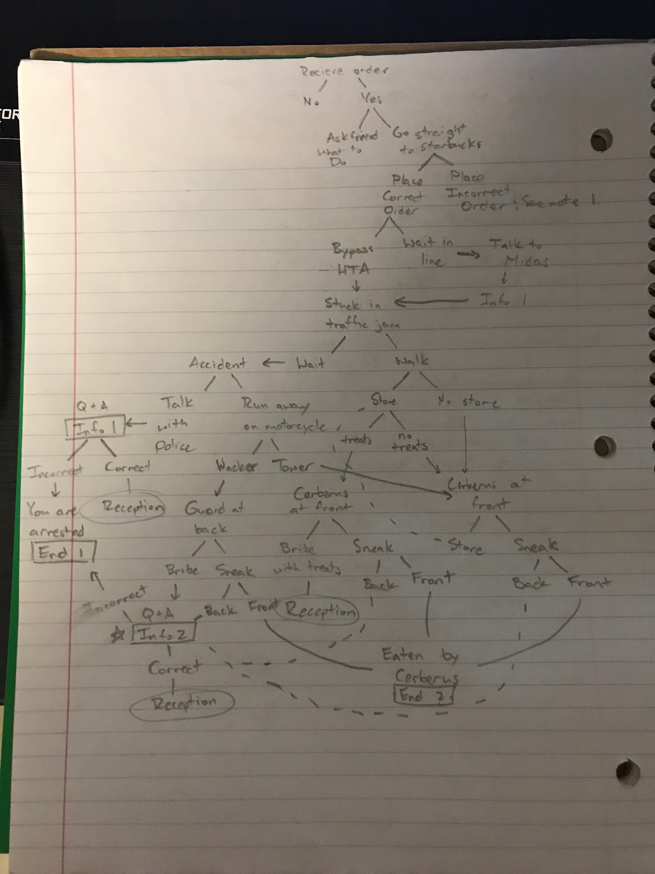
Brainstorming
Grow the tree
List your characters and necessary tech/magic
Build the world out from there
“Kill your babies” - we had lots of good ideas that are left in the bible and never made it to the game.
Notes:
Cole

Slide 6
2.
The Twine Map from Hell
A terrifying ant monster standing on its head.
Notes:
Patrick

Slide 7
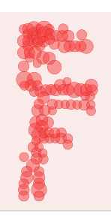
Mapping it out
Fleshing out the tree took details and code
Learned HTML, CSS, and JavaScript
Open world cluster at the top
More railroaded at the end
Notes:
Patrick

Slide 8
3.
The Game Review from Hell
A self-aware critique of our product

Slide 9
What Worked and What Didn’t: Playtesting
Good!
Comedic Elements
Good Hook
Enjoyable Characters
Bad!
Disjointed Story Elements
Clear Success and Failure
Check to make sure programming works
Notes:
Justin

Slide 10
What Worked and What Didn’t:
Our Thoughts
Good!
Distinct tasks
Meeting outside of class
Attaching characters to a purpose
Bad!
Building the endings and mechanics first instead of the story
Start Specific
Communicating Story Elements
Notes:
Justin

Slide 11
THANKS!
Any questions?
Notes:
All

Slide 12
CREDITS
Presentation template by SlidesCarnival
Game made with Twine software
Notes:
No one

